Slide 1
Chemical Energy
Not long enough add more

Slide 2
Understand chemical potential energy.
TRACK WITH ME
READ WITH ME
DEFINITION
Define a key word in the learning objective here.
Describe chemical energy and give examples.
Describe how organisms (such as humans and other animals) gain energy from food.
Read and analyse food energy chats.
DECLARE THE OBJECTIVE
Read the learning objective to your partner.
Notes:
Learning Objectives contain concepts (nouns, big ideas), skills (verbs, measurable behaviours) and sometimes context (restricting or targeting conditions).
●Example: Students will be able to describe the concept of density and apply it to floating and sinking.
Success criteria are specific measurable outcomes that if met mean that the student has met the learning objective.
Examples:
•Students will be able to compare densities of substances using mass and volume.
•Students will be able to identify whether a solid or liquid will float or sink in a liquid based on their densities.

Slide 3
Why do we study chemical energy?
In Australia, we use kilojoules (kJ) to measure how much energy people get from consuming a food or drink.
A kilojoule is a unit of measure of energy, in the same way that kilometres measure distance.
Knowing the energy content of food is vital for your health
MAKE THE CONNECTION Chemical Energy is stored in food

Slide 4
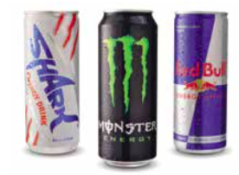
How much energy is in your food?
After we have done a lot of exercise, we often crave foods that we believe will restore our energy levels. ese foods, usually sweet things, release stored chemical energy really quickly to satisfy our cravings.
All foods have some energy stored in them, but the difference is how quickly the energy can be released.
MAKE THE CONNECTION Chemical Energy is stored in Energy drinks

Slide 5
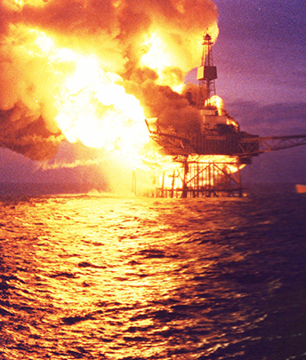
Chemical Energy
Fuels, such as natural gas and petrol, provide us with energy too. A Bunsen burner uses the burning of natural gas to provide heat for laboratory experiments.
Petrol has chemical energy stored in it, as do explosives and batteries.
These devices all contain chemical potential energy that can be released when we need it.
Some batteries can be recharged – the chemical potential energy (CPE) can be replaced.
Piper Alpha – oil platform explosion

Slide 6
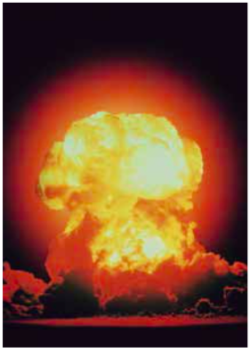
Nuclear energy
Although nuclear energy is used throughout the world, it is not used in Australia.
Nuclear energy involves the reaction at the centre of atoms.
When atoms react in chemical reactions, they usually release only small amounts of energy.
However, if the centres or nuclei of those atoms can be made to react, the amount of energy released is much, much larger.
In fact, the amount of energy released is so huge that it can cause massive amounts of destruction.

Slide 7

DEFINITION
Notes:
How much energy is in your food

Slide 8
Check your understanding
1. What type of energy is stored in a battery?
2. We get our energy from the chemicals in food. What type of energy is this?
3. Biofuel is an alternative source of energy that comes from burning the energy stored in plants. What type of potential energy is biofuel?

Slide 10
Understand chemical potential energy.
TRACK WITH ME
READ WITH ME
DEFINITION
Define a key word in the learning objective here.
Describe chemical energy and give examples.
Describe how organisms (such as humans and other animals) gain energy from food.
Read and analyse food energy chats.
DECLARE THE OBJECTIVE
Read the learning objective to your partner.
Notes:
Learning Objectives contain concepts (nouns, big ideas), skills (verbs, measurable behaviours) and sometimes context (restricting or targeting conditions).
●Example: Students will be able to describe the concept of density and apply it to floating and sinking.
Success criteria are specific measurable outcomes that if met mean that the student has met the learning objective.
Examples:
•Students will be able to compare densities of substances using mass and volume.
•Students will be able to identify whether a solid or liquid will float or sink in a liquid based on their densities.

